Slide 1
Machine Learning
TYPES

Slide 2
Supervised Machine Learning
Linear Regression
Logistic Regression
Decision Tree

Slide 3
Linear Regression
Linear regression is a type of supervised machine-learning algorithm that learns from the labelled datasets and maps the data points with most optimized linear functions which can be used for prediction on new datasets.
It assumes that there is a linear relationship between the input and output, meaning the output changes at a constant rate as the input changes. This relationship is represented by a straight line.
There are 2 variables :
Independent variable (input)
Dependent variable (output)

Slide 4
Best Fit Line in Linear Regression
In linear regression, the best-fit line is the straight line that most accurately represents the relationship between the independent variable (input) and the dependent variable (output).
It is the line that minimizes the difference between the actual data points and the predicted values from the model.
Goal of the Best-Fit Line
The goal of linear regression is to find a straight line that minimizes the error (the difference) between the observed data points and the predicted values. This line helps us predict the dependent variable for new, unseen data.

Slide 5
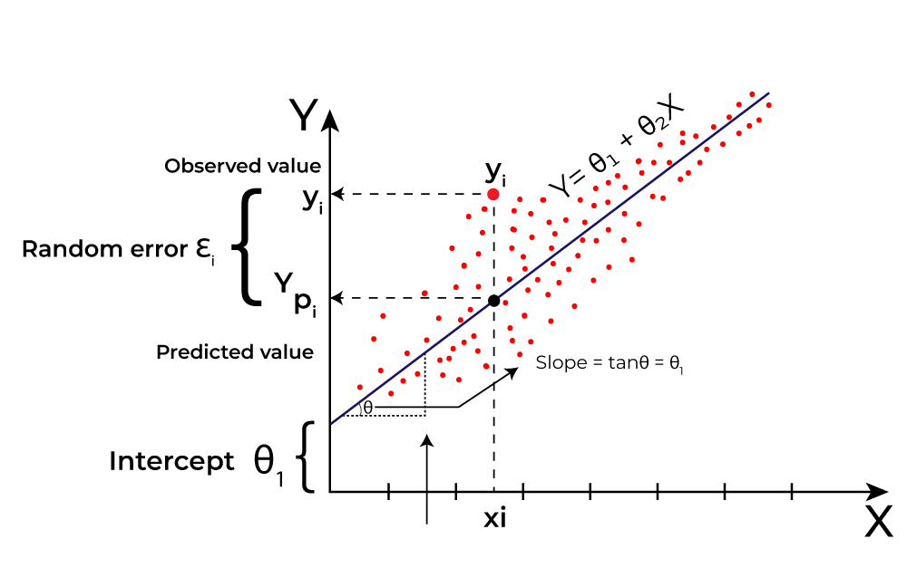

Slide 6
Here Y is called a dependent or target variable and X is called an independent variable also known as the predictor of Y.
Equation of the Best-Fit Line
For simple linear regression (with one independent variable), the best-fit line is represented by the equation
Y=mx+b
y is the predicted value (dependent variable)
x is the input (independent variable)
m is the slope of the line (how much y changes when x changes)
b is the intercept (the value of y when x = 0)

Slide 7
Minimizing the Error: The Least Squares Method
To find the best-fit line, we use a method called Least Squares. The idea behind this method is to minimize the sum of squared differences between the actual values (data points) and the predicted values from the line. These differences are called residuals.
Residual=yᵢ−y_i
yᵢ is the actual observed value
Y_​ᵢ is the predicted value from the line for that xᵢxᵢ
Sumofsquarederrors(SSE)=Σ(yᵢ−y^_ᵢ)²
Interpretation of the Best-Fit Line

Slide 8
Slope (m): The slope of the best-fit line indicates how much the dependent variable (y) changes with each unit change in the independent variable (x). For example if the slope is 5, it means that for every 1-unit increase in x, the value of y increases by 5 units.
Intercept (b): The intercept represents the predicted value of y when x = 0. It’s the point where the line crosses the y-axis.

Slide 9
Types of Linear Regression
Simple Linear Regression
It is used when we want to predict a target value (dependent variable) using only one input feature (independent variable). It assumes a straight-line relationship between the two.
Y_​=θ0​+θ1​x
Where:
Y_​​ is the predicted value
xis the input (independent variable)
θ0 is the intercept (value of y_when x=0)
θ1​​ is the slope or coefficient (how much y_​​ changes with one unit of x)

Slide 10
Multiple Linear Regression
involves more than one independent variable and one dependent variable. The equation for multiple linear regression is:
Y_​=θ0​+θ1​x1​+θ2​x2​+⋯+θn​xn​
Y_ is the predicted value
x1,x2,…,xnx1​,x2​,…,xn​ are the independent variables
θ1,θ2,…,θnθ1​,θ2​,…,θn​ are the coefficients (weights) corresponding to each predictor.
θ0​ is the intercept.

Slide 11
Cost function for Linear Regression
In Linear Regression, the Mean Squared Error (MSE) cost function is employed, which calculates the average of the squared errors between the predicted values y^iy^​i​ and the actual values yiyi​. The purpose is to determine the optimal values for the intercept θ1θ1​ and the coefficient of the input feature θ2θ2​ providing the best-fit line for the given data points. The linear equation expressing this relationship is y_i=θ1+θ2xiy_​i​=θ1​+θ2​xi​.
Evaluation Metrics for Linear Regression
1. Mean Square Error (MSE)
is an evaluation metric that calculates the average of the squared differences between the actual and predicted values for all the data points.

Slide 12
MSE=n1​∑i=1n​(yi​−yi​​)2
nis the number of data points.
yiyi​is the actual or observed value for the ith data point.
yi^yi​​ is the predicted value for the ithi data point.
. Mean Absolute Error (MAE)
is an evaluation metric used to calculate the accuracy of a regression model. MAE measures the average absolute difference between the predicted values and actual values.
Root Mean Squared Error (RMSE)
It describes how well the observed data points match the expected values or the model's absolute fit to the data.

Slide 13
Coefficient of Determination (R-squared)
is a statistic that indicates how much variation the developed model can explain or capture. It is always in the range of 0 to 1.
Adjusted R-Squared Error
accounts the number of predictors in the model and penalizes the model for including irrelevant predictors that don't contribute significantly to explain the variance in the dependent variables.

Slide 14
Regularization Techniques for Linear Models
Lasso Regression (L1 Regularization)
is a technique used for regularizing a linear regression model, it adds a penalty term to the linear regression objective function to prevent overfitting.
J(θ)=2m1​∑i=1m​(yi​​−yi​)2+λ∑j=1n​∣θj​∣
the first term is the least squares loss, representing the squared difference between predicted and actual values.
the second term is the L1 regularization term, it penalizes the sum of absolute values of the regression coefficient θ_{j}.

Slide 15
Ridge Regression (L2 Regularization)
Ridge regression is a linear regression technique that adds a regularization term to the standard linear objective
J(θ)=2m1​∑i=1m​(yi​​−yi​)2+λ∑j=1n​θj2​
the first term is the least squares loss, representing the squared difference between predicted and actual values.
the second term is the L1 regularization term, it penalizes the sum of square of values of the regression coefficient θ_{j}.

Slide 16
Logistic Regression
It is used for binary classification where the output can be one of two possible categories such as Yes/No, True/False or 0/1. It uses sigmoid function to convert inputs into a probability value between 0 and 1. In this article, we will see the basics of logistic regression and its core concepts.
Types of Logistic Regression
Binomial Logistic Regression: This type is used when the dependent variable has only two possible categories. Examples include Yes/No, Pass/Fail or 0/1. It is the most common form of logistic regression and is used for binary classification problems.
Multinomial Logistic Regression: This is used when the dependent variable has three or more possible categories that are not ordered. For example, classifying animals into categories like "cat," "dog" or "sheep." It extends the binary logistic regression to handle multiple classes.

Slide 17
Ordinal Logistic Regression: This type applies when the dependent variable has three or more categories with a natural order or ranking. Examples include ratings like "low," "medium" and "high." It takes the order of the categories into account when modeling
Understanding Sigmoid Function
The sigmoid function is a important part of logistic regression which is used to convert the raw output of the model into a probability value between 0 and 1.
This function takes any real number and maps it into the range 0 to 1 forming an "S" shaped curve called the sigmoid curve or logistic curve. Because probabilities must lie between 0 and 1, the sigmoid function is perfect for this purpose.
In logistic regression, we use a threshold value usually 0.5 to decide the class label.
If the sigmoid output is same or above the threshold, the input is classified as Class 1.
If it is below the threshold, the input is classified as Class 0.

Slide 18
Logistic regression model transforms the linear regression function continuous value output into categorical value output using a sigmoid function which maps any real-valued set of independent variables input into a value between 0 and 1
X=⎣⎡​x11​ x21​ ⋮xn1​ ​......⋱ ...​x1m​x2m​⋮ xnm​​⎦⎤​
and the dependent variable is YYhaving only binary value i.e 0 or 1.
xi​ is the ithith observation of X, wi=[w1,w2,w3,⋯,wm]wi​=[w1​,w2​,w3​,⋯,wm​] is the weights or Coefficient and bbis the bias term also known as intercept. Simply this can be represented as the dot product of weight and bias.
z=w⋅X+b
At this stage, zzis a continuous value from the linear regression. Logistic regression then applies the sigmoid function to zzto convert it into a probability between 0 and 1 which can be used to predict the class.

Slide 19
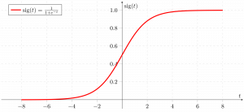

Slide 20
How to Evaluate Logistic Regression Model?
Accuracy: Accuracy provides the proportion of correctly classified instances. Accuracy=TruePositives+TrueNegativesTotalAccuracy=TotalTruePositives+TrueNegatives​
Precision: Precision focuses on the accuracy of positive predictions. Precision=TruePositivesTruePositives+FalsePositivesPrecision=TruePositives+FalsePositivesTruePositives​
Recall (Sensitivity or True Positive Rate): Recall measures the proportion of correctly predicted positive instances among all actual positive instances. Recall=TruePositivesTruePositives+FalseNegativesRecall=TruePositives+FalseNegativesTruePositi

Slide 21
F1 Score: F1 score is the harmonic mean of precision and recall. F1Score=2∗Precision∗RecallPrecision+RecallF1Score=2∗Precision+RecallPrecision∗Recall​
Area Under the Receiver Operating Characteristic Curve (AUC-ROC): The ROC curve plots the true positive rate against the false positive rate at various thresholds. AUC-ROC measures the area under this curve which provides an aggregate measure of a model's performance across different classification thresholds.
Area Under the Precision-Recall Curve (AUC-PR): Similar to AUC-ROC, AUC-PR measures the area under the precision-recall curve helps in providing a summary of a model's performance across different precision-recall trade-offs.

Slide 22
AUC ROC Curve in Machine Learning
AUC-ROC curve is a graph used to check how well a binary classification model works. It helps us to understand how well the model separates the positive cases like people with a disease from the negative cases like people without the disease at different threshold level. It shows how good the model is at telling the difference between the two classes by plotting:
True Positive Rate (TPR): how often the model correctly predicts the positive cases also known as Sensitivity or Recall.
False Positive Rate (FPR): how often the model incorrectly predicts a negative case as positive.
Specificity: measures the proportion of actual negatives that the model correctly identifies. It is calculated as 1 - FPR.

Slide 23
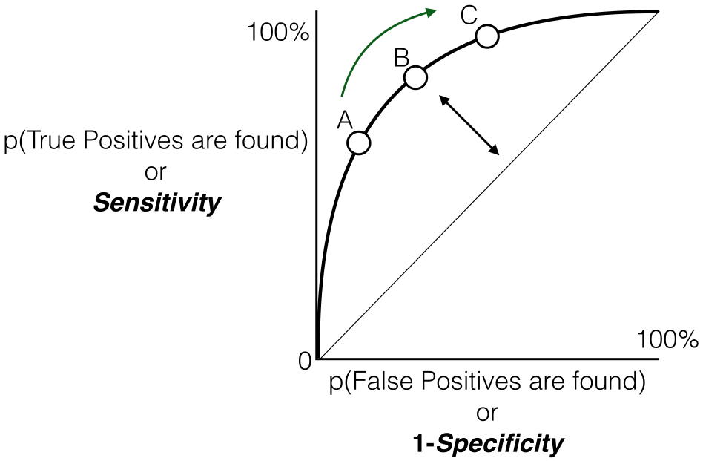

Slide 24
Decision Tree in Machine Learning
A decision tree is a supervised learning algorithm used for both classification and regression tasks. It has a hierarchical tree structure which consists of a root node, branches, internal nodes and leaf nodes. It It works like a flowchart help to make decisions step by step where:
Internal nodes represent attribute tests
Branches represent attribute values
Leaf nodes represent final decisions or predictions.
How Does a Decision Tree Work?
A decision tree splits the dataset based on feature values to create pure subsets ideally all items in a group belong to the same class. Each leaf node of the tree corresponds to a class label and the internal nodes are feature-based decision points.

Slide 25
Information Gain and Gini Index in Decision Tree
Information Gain
Information Gain tells us how useful a question (or feature) is for splitting data into groups. It measures how much the uncertainty decreases after the split. A good question will create clearer groups and the feature with the highest Information Gain is chosen to make the decision.
Entropy: is the measure of uncertainty of a random variable it characterizes the impurity of an arbitrary collection of examples. The higher the entropy more the information content.

